Slide 1

Customer Shopping Behavior Analysis
Analysis of 3,900 transactions to reveal spending patterns, segments, product preferences, and subscription behavior to guide strategic decisions.

Slide 2

Dataset Snapshot
Scope
Key Features
Data Quality
3,900 rows × 18 columns covering demographics, purchases, and behavior.
Age, Gender, Location, Item, Category, Purchase Amount, Season, Rating, Subscription, Shipping, Discounts.
37 missing values in Review Rating; addressed during cleaning.

Slide 3

Python EDA & Preparation
Loading & Inspection
Imported with pandas; used df.info() and .describe() for structure and summaries.
Missing Data
Imputed Review Rating with category median values.
Feature Engineering
Added age_group and purchase_frequency_days; standardized column names to snake_case.
Redundancy
Dropped promo_code_used after checking redundancy with discount_applied.

Slide 4
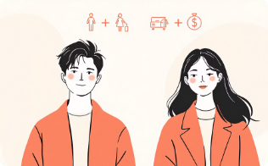


SQL Analysis — Key Findings
Revenue by Gender
High-Spending Discount Users
Top Rated Products
Male: 157,890 • Female: 75,191 — clear revenue gap favoring male customers.
839 rows identified where customers used discounts yet spent above average.
Top 5 by avg rating: Gloves (3.86), Sandals (3.84), Boots (3.82), Hat (3.80), Skirt (3.78).

Slide 5
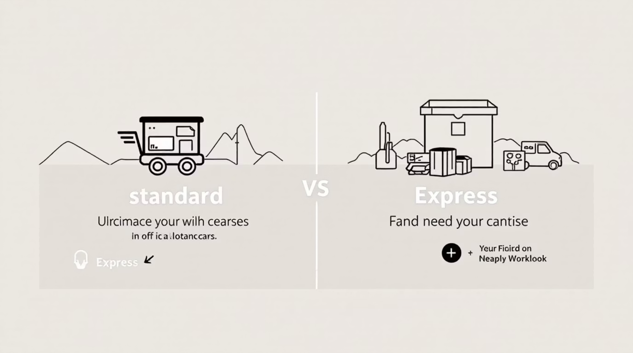
Behavioral & Shipping Insights
Shipping Comparison
Average purchase: Standard = 58.46, Express = 60.48 — express slightly higher.
Subscribers vs Non-Subscribers
Subscribers: 1,053 customers, avg spend 59.49, total revenue 62,645. Non-subscribers: 2,847 customers, avg spend 59.87, total revenue 170,436.
Discount-Dependent Products
Highest discount rates: Hat 50.00%, Sneakers 49.66%, Coat 49.07%, Sweater 48.17%, Pants 47.37%.

Slide 6

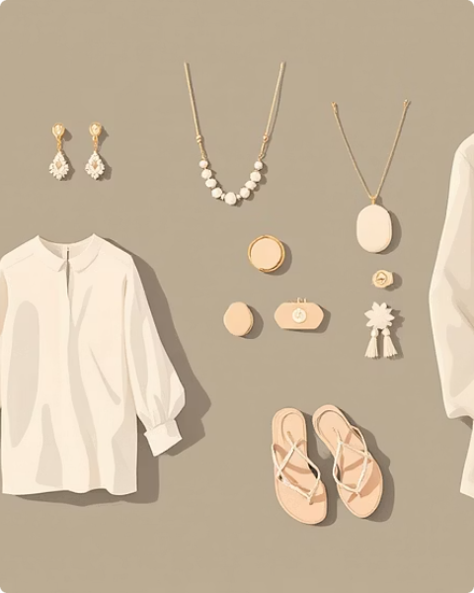

Segmentation & Top Products
Customer Segments
Top Products by Category
Revenue by Age Group
Loyal: 3,116 • Returning: 701 • New: 83 — majority classified as Loyal.
Accessories: Jewelry, Sunglasses, Belt. Clothing: Blouse, Pants, Shirt. Footwear: Sandals, Shoes, Sneakers. Outerwear: Jacket, Coat.
Young Adult: 62,143 • Middle-aged: 59,197 • Adult: 55,978 • Senior: 55,763.

Slide 7
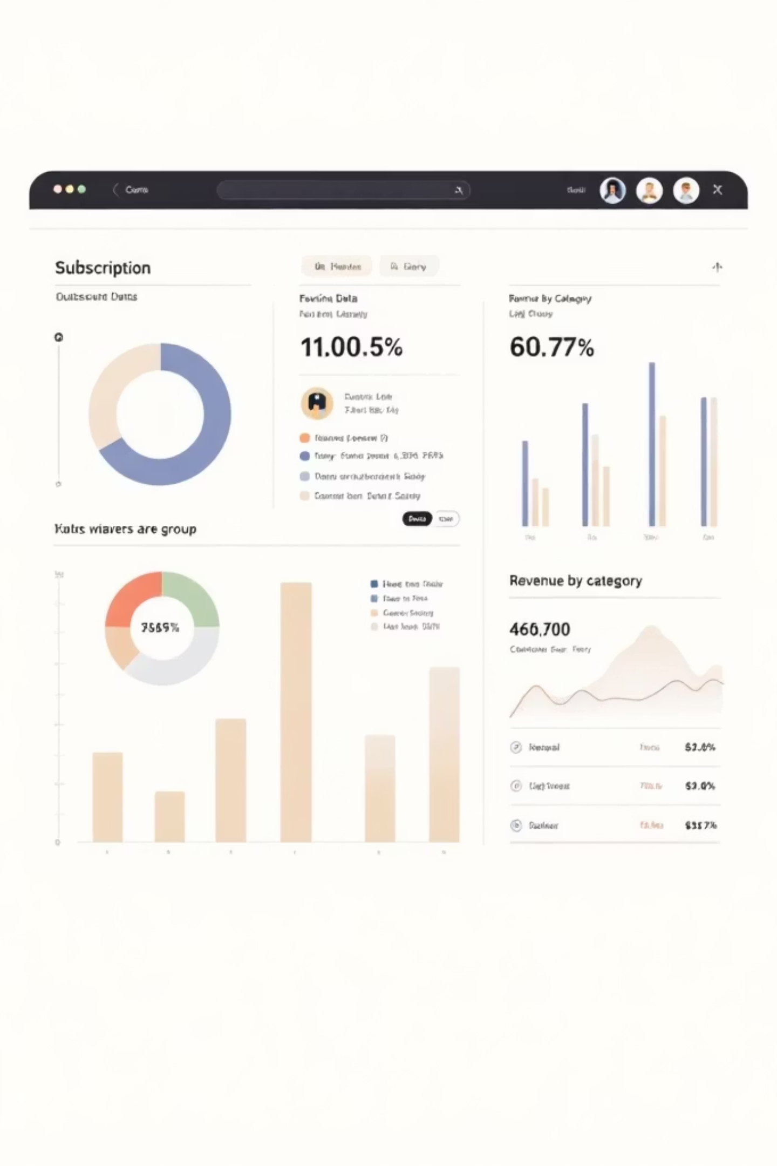
Dashboard Highlights (Power BI)
Dashboard visualizes: Subscription split (27% Yes / 73% No), Revenue by Category (Clothing ~100K highest), Sales by Category (Clothing ~1,800 highest), Revenue & Sales by Age Group (Young Adult leads).

Slide 8

Business Recommendations
Boost Subscriptions
Customer Loyalty Programs
Promote exclusive benefits to convert non-subscribers and lift recurring revenue.
Reward repeat buyers to expand the Loyal segment and increase lifetime value.
Review Discount Policy
Product Positioning & Targeting
Balance promotional lift with margins; target discounts to high-conversion SKUs.
Feature top-rated, best-selling items in campaigns and target high-revenue age groups and express-shipping users.

